Slide 1
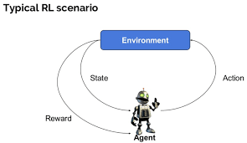
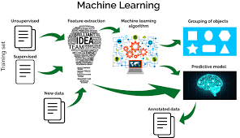
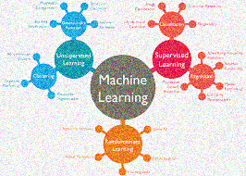

Slide 2
The Program's Table Of Contents
1. Introduce RF Algorithm And Explanation How It Work
2. Introduce LR Algorithm And Explanation How It Work
3.Demo Both Algorithm Above (If It Available)
4.The End

Slide 3



Random Forest

Slide 4
Company | Job | Degree | Salary More Than 1000$
Google | Sales executive | Bachelors | 0
Google | Sales executive | Masters | 0
Google | Business manager | Bachelors | 1
Google | Business manager | Masters | 1
Google | Computer programmer | Bachelors | 0
Google | Computer programmer | Masters | 1
ABC pharma | Sales executive | Masters | 0
ABC pharma | Computer programmer | Bachelors | 0
ABC pharma | Business manager | Bachelors | 0
Abc pharma | Business manager | Masters | 1
Facebook | Sales executive | Bachelors | 1
Facebook | Sales executive | Masters | 1
Facebook | Business manager | Bachelors | 1
Facebook | Business manager | Masters | 1
Facebook | Computer programer | Bachelors | 1
Facebook | Computer programer | Masters | 1
Dataset Training
Company
Google
Facebook
ABC Pharma
Sales
Executive
Yes
Business Manager
Sales Executive
Computer
Programmer
Computer Programmer
Business
Manager
No
No
No
Yes
Master
Yes
Bachelors
Master
Bachelors
Yes
No
No

Slide 5
Decision Tree Model

Slide 6
Random Forest Model
-
n
1
2
Decision
Decision
Decision
Majority Vote
Decision

Slide 7


Hey Bro
Should I Buy A Type Of Computer

Slide 8

Friend 1
Friends 2
Friend 3

Slide 9

I Have A Decision

Slide 10
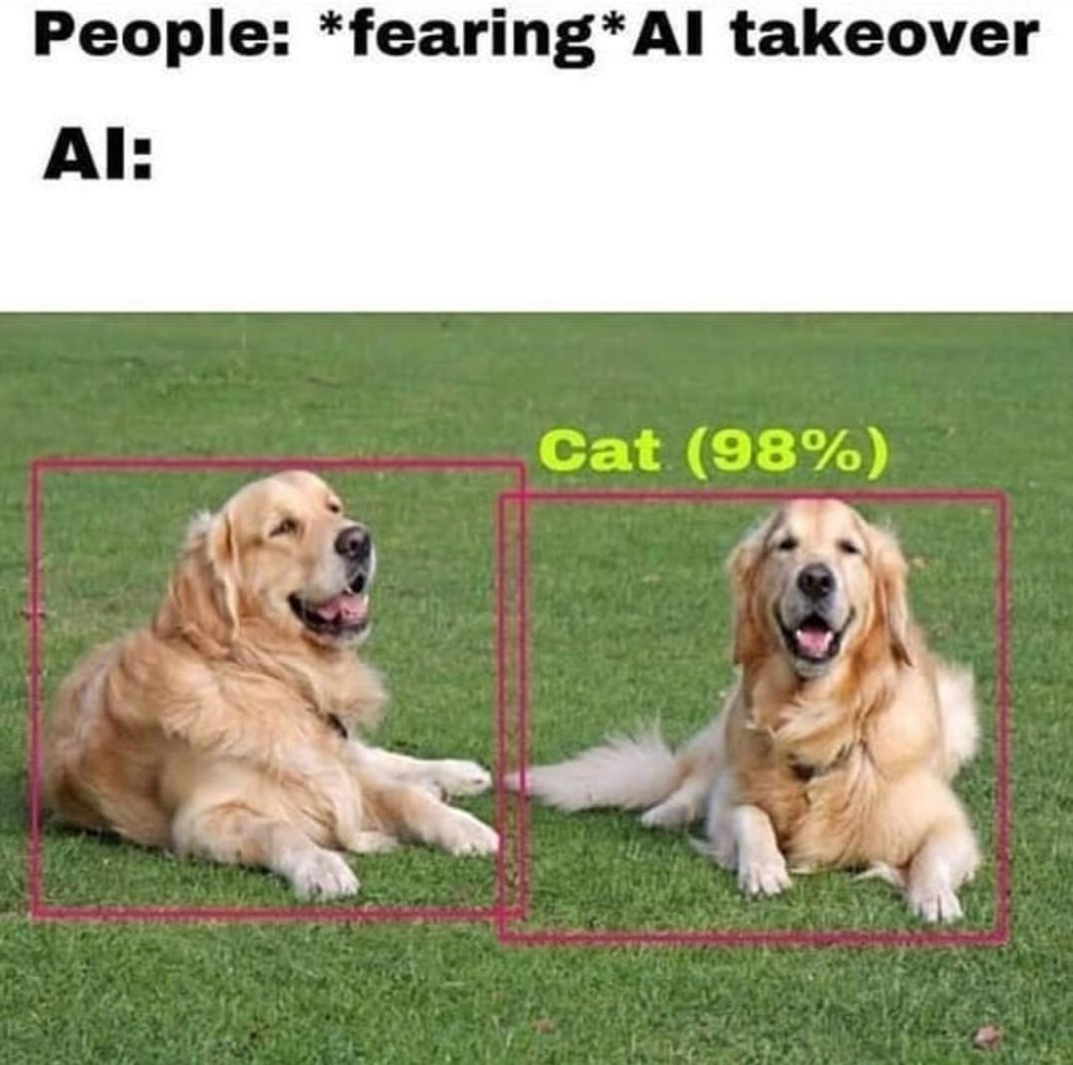

Slide 11
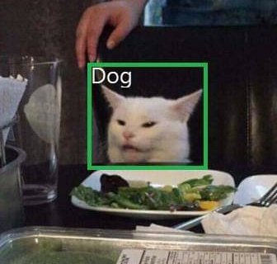

Slide 12
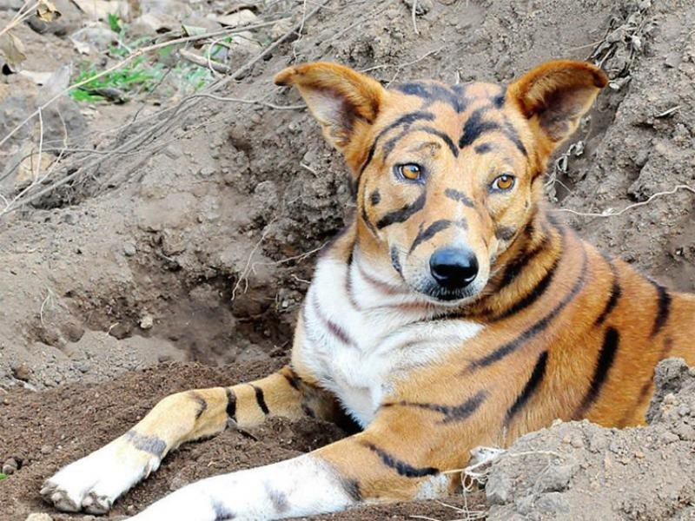

Slide 13
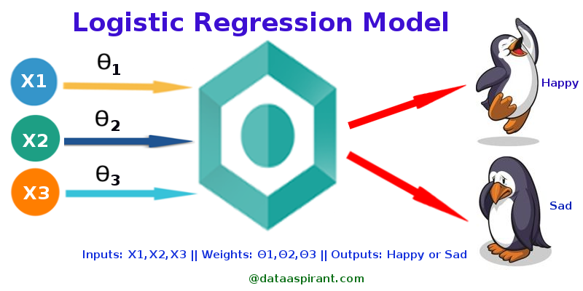
2.Logictis Regression

Slide 14
Classification
Linear Regression
Home prices
Weather
Stock price
Email is spam or not
Will customer buy life insurance
Which party a person is going to vote for?
Democratic
Republican
Independent
Predicted value is
continuous
Predicted value is
categorical

Slide 15
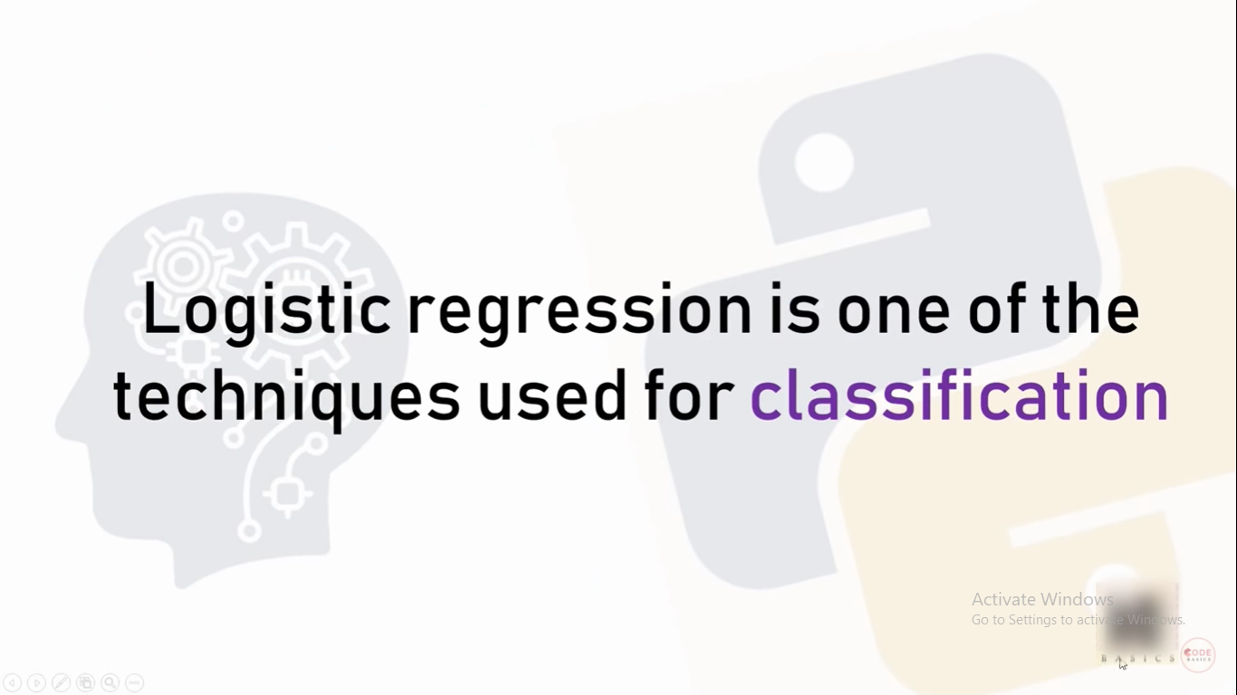

Slide 16
Classification Types
Will customer buy life
insurance?
1. Yes
2. No
Which party a person is going to vote for?
1. Democratic
2. Republican
3. Independent
Binary Classification
Multiclass Classification

Slide 17
Age | Have_insurance
22 | 0
25 | 0
47 | 1
52 | 0
46 | 1
56 | 1
55 | 0
60 | 1
62 | 1
61 | 1
18 | 0
28 | 0
27 | 0
29 | 0
49 | 1

Slide 18
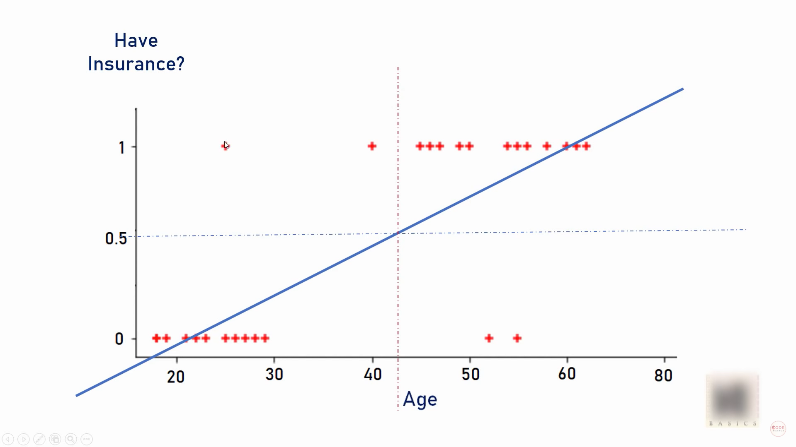

Slide 19
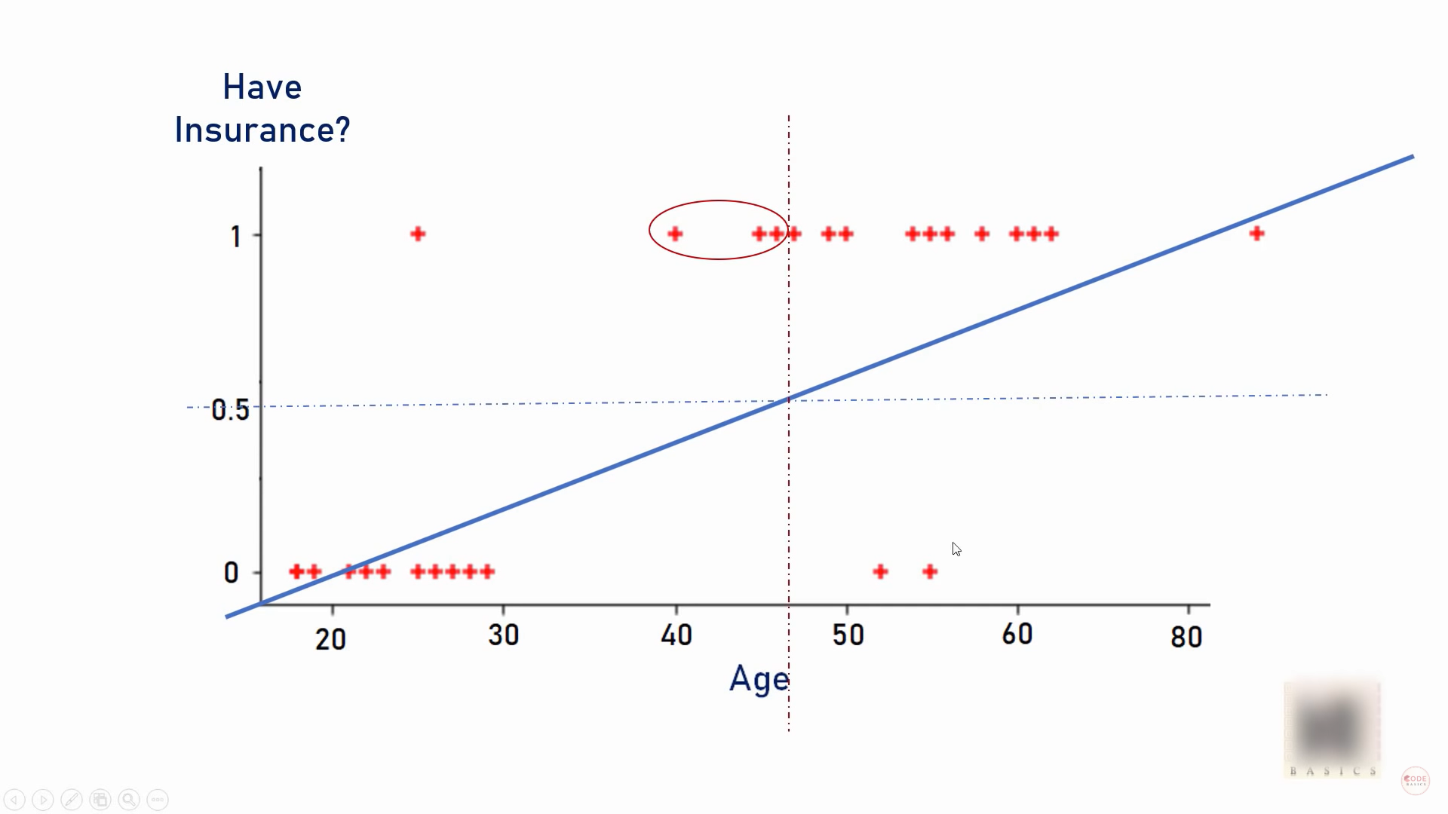

Slide 20
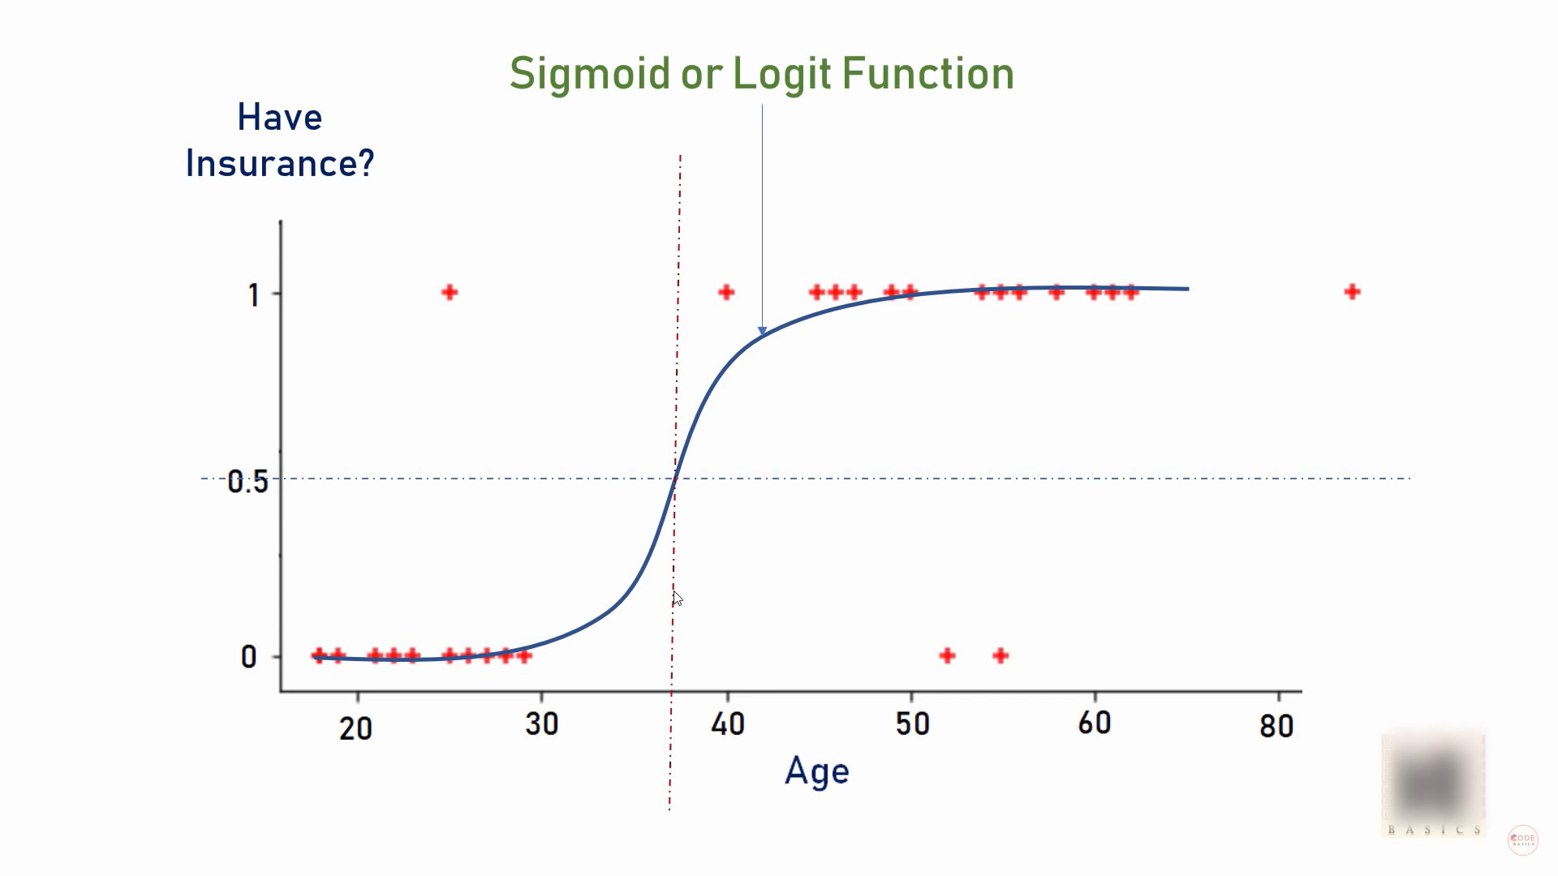

Slide 21
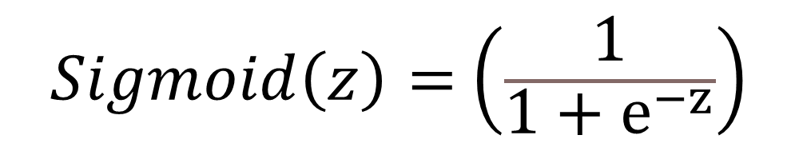
$$\left.Sigmoid\left(z\right)= ( \frac{1}{1+ⅇ^{−z}}\right)$$
e = Euler’s number ~ 2,71828
Sigmoid function converts input into range 0 to 1

Slide 22
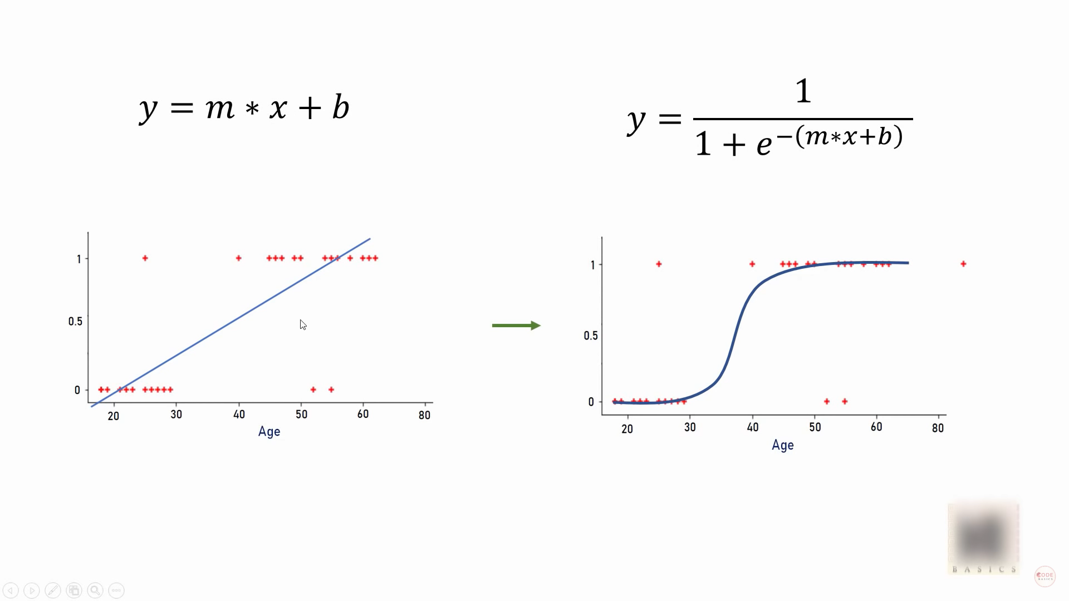

Slide 23
3. Demo Logistics Regression And Random Forest With Iris Dataset

Slide 24


Slide 25
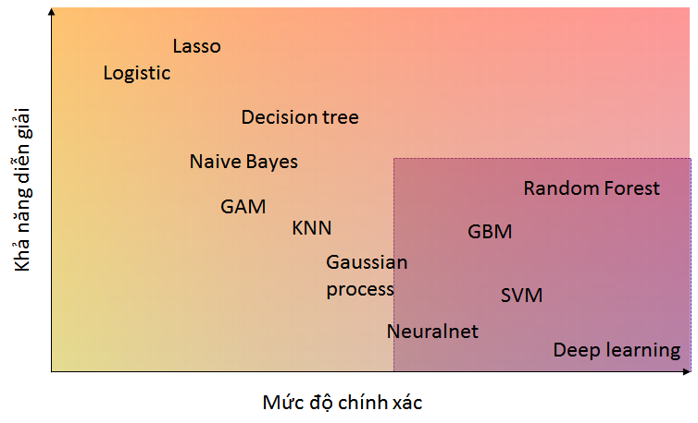

Slide 26

Setosa

Slide 27
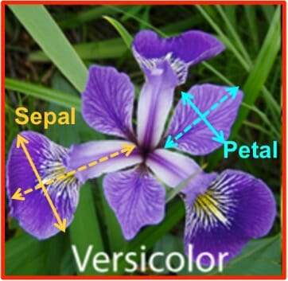
Versicolor

Slide 28

Virginica

Slide 29


